Slide 1
COURSE CODE:
INFT 352
TITLE:
Advanced Web Engineering and Application With PHP
LECTURER/ INSTRUCTOR: P.M SARFO

Slide 2
PHP HISTORY
Developed b Rasmus Lerdorf in 1994.
For personal use - help him track visitors on his personal home page.
PHP is used to be called Personal Home Page, currently called Php Hypertext Preprocessor.

Slide 3
Introduction to PHP and Web Environment
PHP is a widely-used, open-source, server-side scripting language primarily used for web development. It is known for its ability to create dynamic and interactive web pages, making it a keystone for creating web applications.
PHP's versatility extends to interacting with databases, processing form data, and generating content, all while seamlessly integrating with HTML.
PHP code runs on the web server, not the user's browser. This means the server processes the code and sends the resulting HTML to the user's browser.

Slide 4
What Can PHP Do?
PHP can generate dynamic page content
PHP can create, open, read, write, delete, and close files on the server
PHP can collect form data
PHP can send and receive cookies
PHP can add, delete, modify data in your database
PHP can be used to control

Slide 5
The core PHP language (version 7+) features powerful string- and array-handling facilities, as well as greatly improved support for object-oriented programming.
With the use of standard and optional extension modules, a PHP application can interact with a database such as MySQL or Oracle, draw graphs, create PDF files, and parse XML files.

Slide 6
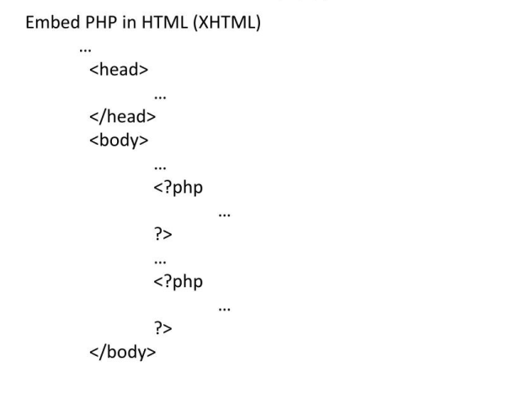
How is Programmed

Slide 7
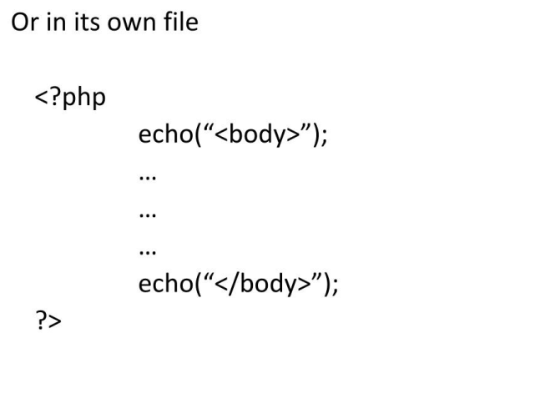

Slide 8
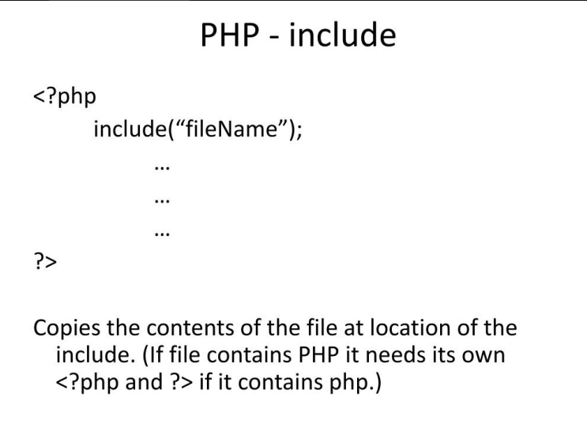

Slide 9
Scripting Language
A scripting language is a type of programming language designed for automating tasks, often by interpreting code one line at a time, rather than requiring a full compilation process.
They are commonly used for tasks like automating processes, simplifying complex operations, and integrating different software applications.

Slide 10
Scripting languages in essence, are a series of commands that are able to be executed without the need for compiling.
All scripting languages are programming languages, but not all programming languages are scripting languages.
JavaScript, Python, and Ruby are all examples of scripting languages.

Slide 11
Client-side scripting
Client-side scripting is a type of web programming where the code runs in the user’s browser after the page is loaded. It is used to create interactive and responsive websites without needing to contact the server for every action.
Examples of client-side scripting languages:
JavaScript
HTML
CSS

Slide 12
Key Features:
Code runs on the client’s browser
The user can see and access the client-side code
Used to change content, validate forms, create animations, etc.

Slide 13
Server-side scripting
Server-side scripting is a type of web programming where the code runs on the web server before the page is sent to the user's browser. It is used to create dynamic content, interact with databases, manage user sessions, and handle form submissions.
Examples of server-side scripting languages:
PHP
Python (with Django or Flask)
Node.js
Ruby
ASP.NET

Slide 14
Key Features:
Code runs on the server
The user cannot see the server-side code
Often used to fetch, store, or process data in a database.

Slide 15
Server-Side Scripting
Imagine you're ordering a pizza from a restaurant. You (the user) tell the waiter (your computer) what you want. The waiter goes into the kitchen (the server), where the pizza is made. You don't see what happens in the kitchen — you just get the finished pizza.
🍕 So in server-side scripting:
The "kitchen" is the server, where the secret work (like saving info or talking to a database) happens.
You only get the result, like a web page or message.

Slide 16
Client-Side Scripting
Now imagine you're playing with a toy that makes sounds and lights up when you press buttons.
Everything happens right in front of you — no need to ask someone else to do it.
💡 So in client-side scripting:
The browser (like Chrome) does all the work on your computer.
It changes colors, moves things, checks what you typed, and more — all without talking to the server.

Slide 17
SERVER-SIDE vs CLIENT-SIDE
SERVER-SIDE | CLIENT-SIDE
Executes on server | Executes in browser
Handles business logic | Enhances user interface
Examples: PHP, Python | Examples: JavaScript, HTML
Can access databases | Cannot access server or DB directly

Slide 18
Setting Up the Development Environment
Download and install XAMPP for Apache + MySQL + PHP.
Use Visual Studio Code as the code editor.
PHP files must be stored in the htdocs directory.
Access files via http://localhost/yourfilename.php.

Slide 19
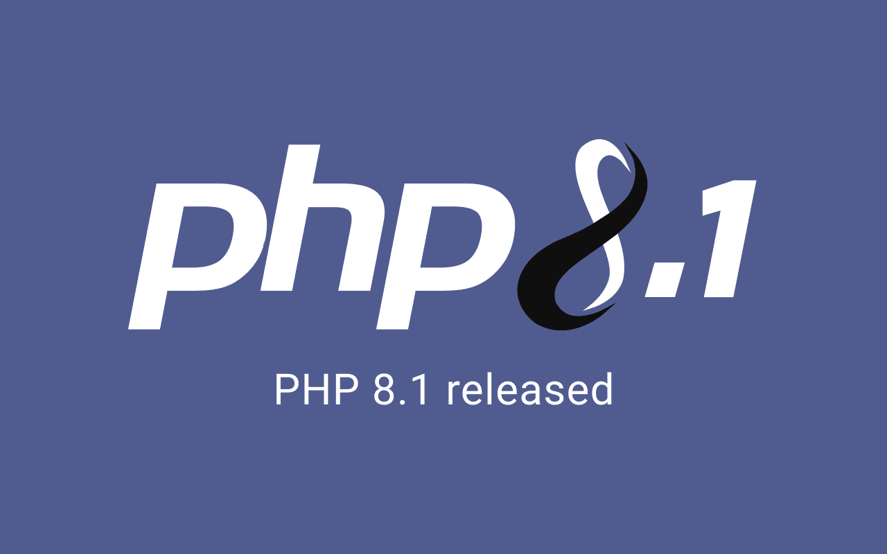

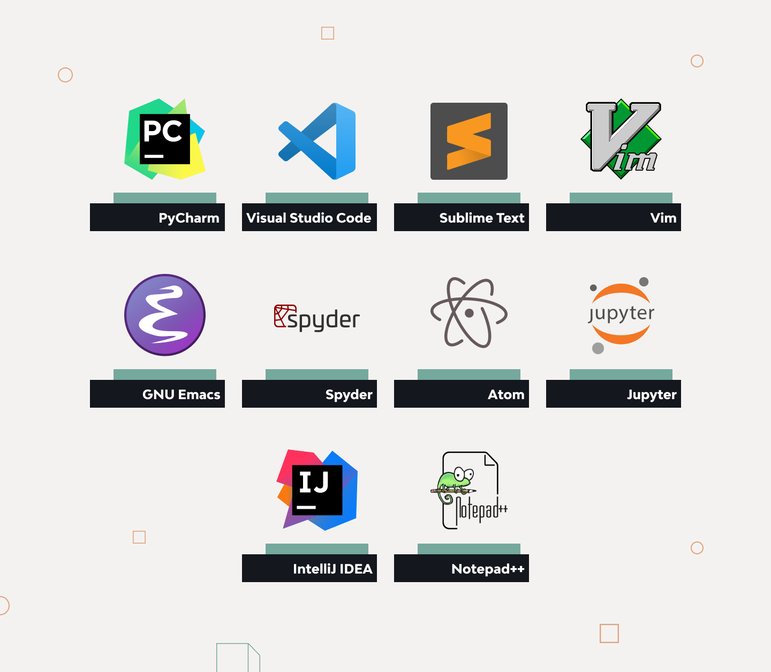
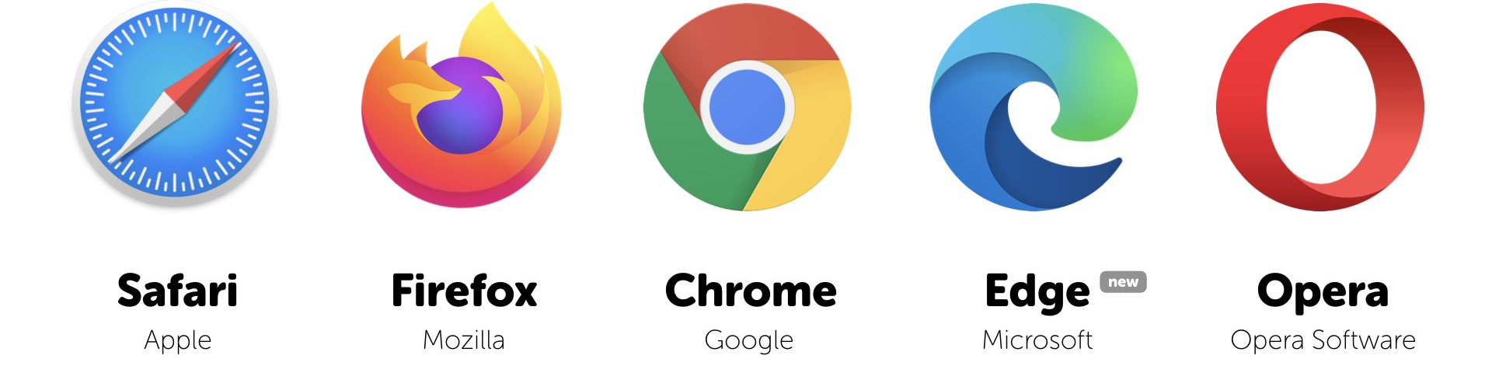
TOOLS NEEDED

Slide 20
Basic PHP Syntax
<?php
echo "Hello, world!";
?>
PHP code is embedded within <?php ?> tags.
Use echo to output text.
Statements end with ;
Comments: // for single-line, /* */ for multi-line

Slide 21
How PHP Works with the Web Server
1. User Sends a Request
A user types a URL like: http://example.com/index.php
The browser sends a request to the web server for that PHP file.
2. Web Server Receives the Request
The web server (like Apache, Nginx, or IIS) checks the file extension.
If the file ends in .php, the server knows it needs help from the PHP engine.

Slide 22
3. Server Passes the File to PHP Interpreter
The server does not send the .php file directly to the user.
Instead, it passes the file to the PHP interpreter (installed on the server).
4. PHP Code is Executed
The PHP interpreter runs the code on the server.
It can:
Connect to a database
Handle form data
Perform calculations
Generate HTML content

Slide 23
5. PHP Generates HTML
The output of the PHP code is usually HTML.
6. HTML is Sent to Browser
The web server sends only the final HTML output back to the user’s browser.
The browser never sees the PHP code — only the result.
7. Browser Displays the Page
The user sees a fully rendered web page, just like any other website.

Slide 24
Simple Analogy
🧑 User: "I want a pizza!" 🧑‍🍳 Web server: Takes the order 🐘 PHP: Prepares the pizza in the kitchen 🍕 Output: Only the ready-to-eat pizza (HTML) is delivered to the customer

Slide 25
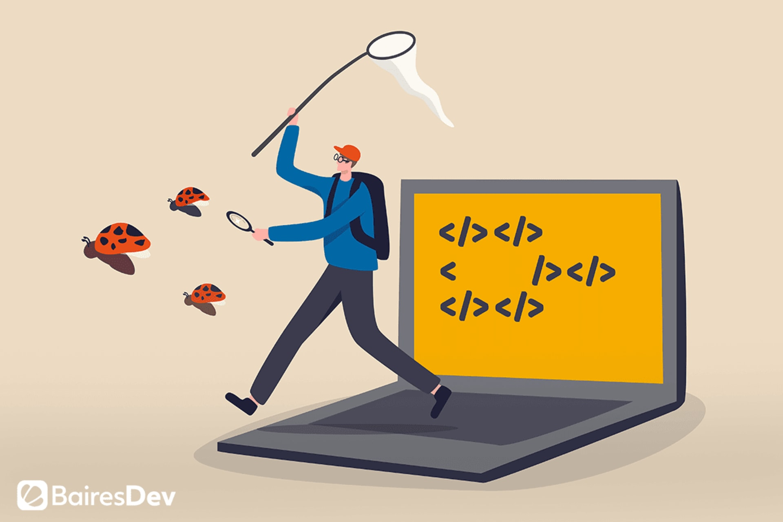
A bug in computing is a mistake or error in a computer program that causes it to do something wrong or unexpected.
A bug is a problem in the code that makes the program not work correctly.

Slide 26
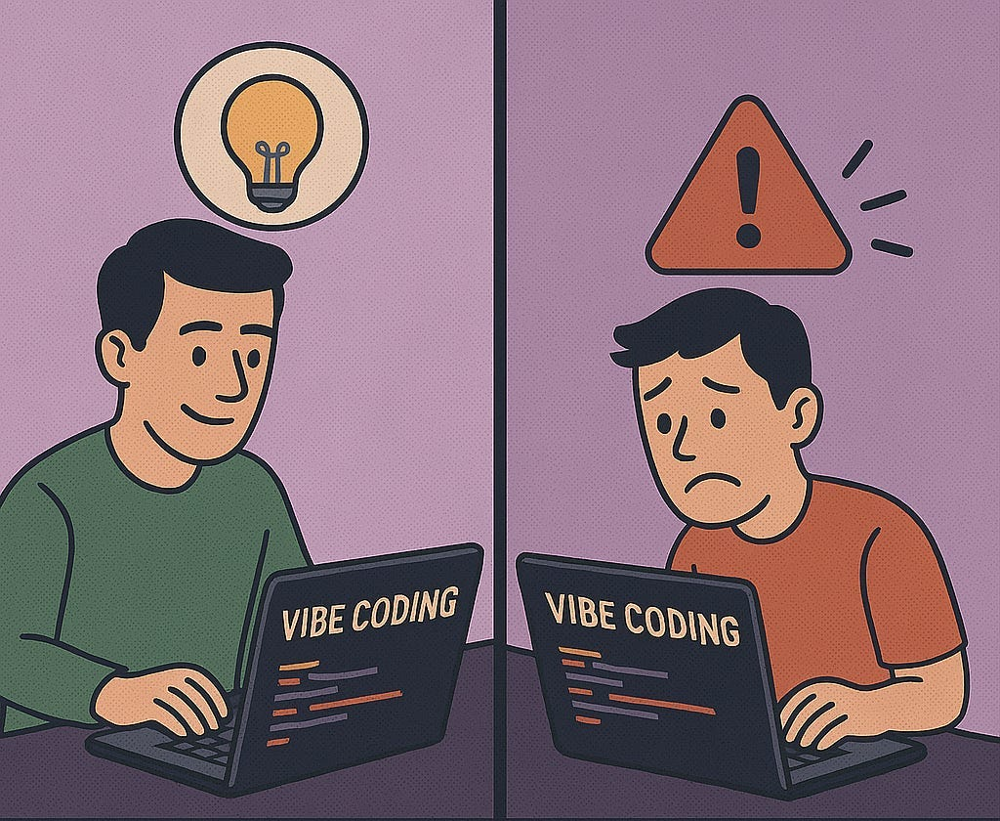
Run Your Code More Often
Use Print Statement Effectively
Google, Google, and Google
Try an Alternate Solution

Slide 27
Debugging Tips
Debugging tips focus on understanding and resolving issues within code.
Key techniques include identifying the problem, isolating the affected code, using debugging tools like breakpoints and logs, and employing methods like binary search or rubber ducking to pinpoint errors and understand code behavior.

Slide 28
THANK YOU
28

